Slide 1










Sales Analysis of a Food Manufacturing Company
By
Abhishek Biswas
Under the guidance of
Ms. Eeshani Agarwal

Slide 2

Table of Contents
01
02
03
Objective of Analysis
About the dataset
Questions I asked
04
05
06
Visualization and Exploration
Insights and Suggestions
Thank You

Slide 3



Objective of Analysis
To analyze the dataset of a Food Manufacturing Company with MySQL Workbench and provide suggestions to management to maximize Sales and Customer Engagement at all of its outlets as well as formulate a marketing strategy to inculcate healthy food habits to the customer base.

Slide 4







About the dataset
The dataset contains information about the Sales of individual items and their Maximum Retail Price across all the stores of the Company. The features are explained as follows:
Item_ID :-
This column shows the individual item Ids of the products.
Item_Weight:-
The weight of the item per unit in grams.
Item_fat_content:-
The fat content of the individual products.
Item_type:-
The type of product.
Item_MRP:-
The maximum retail price of the product.
Outlet_Identifier:-
The unique outlet identifier ID of the outlets.
Yrs_since_Inception:-
The number of years which have passed since the particular outlet was established.
Outlet_size:-
The size of the outlet.
Outlet_location_type:-
The type of location the outlet is situated in.
Outlet_type:-
The type of outlet.
Sales:-
The total sales of the item in the particular outlet.
Number_of_units_sold:-
The number of units sold of a particular item at an outlet.

Slide 5


Questions I asked
What is the number of units sold of low fat and regular fat items across various outlet locations?
Which Item Types are most sold among Various Outlets?
Percentage of all Item Types sold across all outlet types.
Tier wise Sales distribution among various outlets.
Type and number of outlets according to age location wise.
Which Outlet identifier among each location tiers give highest sales.
Are outlets established in the last 15 years giving sales more than the outlets which were established in more than 15 years?
Average MRP of all products across all outlets in all locations to understand the pricing model.
Location tier wise number of each outlet type in 3 different outlet sizes.

Slide 6
Visualization and Exploration

Slide 8
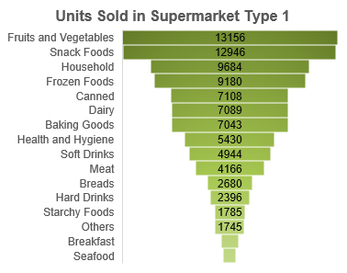
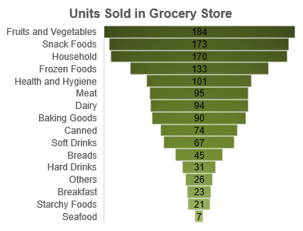

Slide 9
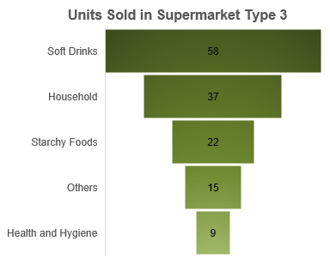
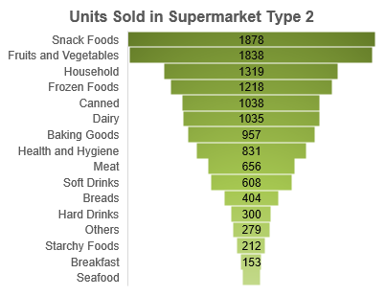

Slide 12
OUT018
OUT045
OUT049

Slide 17


Insights and Suggestions
Seafood is the least bought item across all the outlet types, except in supermarket type 3, where it is not sold at all. Surprisingly health and hygiene products are mostly not bought from Supermarket Type 3, whereas from other supermarkets, that's not the case. Maybe this is happening because of its size and location, where people are not aware about these products.
In tier 1 and 2 locations, medium sized supermarkets are performing very well. In tier 1 cities, customers are inclining towards supermarkets only rather than grocery stores, because of the demography. In tier 3 locations, sales in big sized supermarkets are the most, maybe because of the pricing model.
There are no new outlets in tier 1 locations, which should be focused upon, since people from those locations prefer supermarkets mostly. This can lead to a boost in sales.
The outlets which give maximum sales from all the 3 locations are all medium sized supermarkets.
The average sales in newer outlets are more than older ones. This can be because of the ambience, facilities, location and pricing model of the newer ones which are more appealing to customers.
The price of commodities in supermarkets is more or less same with that of grocery stores in all the 3 locations, which is a part of the pricing strategy of the company, which is to keep the prices competitive.
Big sized supermarkets which give the most sales in tier 3 cities are nonexistent in tier 1 cities. This can be a part of the company's marketing strategy which focuses more on the tier 3 cities rather than tier 1 cities..

Slide 18

THANK YOU!

